Slide 1


Elevate your Mobile Testing

Slide 2


Content
Introduction
Prerequisites
Framework Architecture
Setting Up the Project
Demo
Conclusion

Slide 3
Introduction
Tools and technologies
Mobile app automation testing involves using automated scripts to test mobile applications on various devices and platforms, ensuring their functionality, performance, and user experience.
Automation frameworks help organize and structure test scripts, making them easier to maintain, reusable, and scalable. They also provide reporting capabilities and enhance collaboration among team members.
Appium (for mobile app automation)
Cucumber (for behavior-driven development)
TestNG (for test execution and reporting)
Selenium (for web automation using Java)
Appium Inspector: A graphical tool for inspecting and interacting with mobile app elements during test script development and debugging

Slide 4
Java JDK
Appium Server
IDE
Android SDK/Xcode
-Needed to write and run Java code.
For Android/iOS mobile app testing, respective SDKs must be installed.
To interact with mobile devices and execute automation tests.
An Integrated Development Environment (e.g., Eclipse, IntelliJ) for writing and managing code.
-Latest version preferred 8 upwards
Prerequisites
prerequisites required for setting up the automation framework

Slide 5
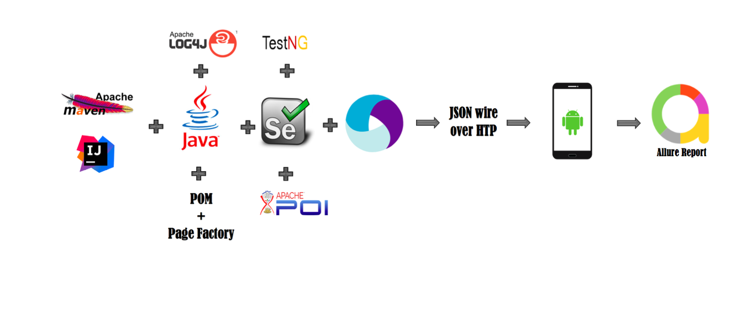


Framework Architecture
Hybrid Framework
Notes:
Combines the benefits of BDD, POM, and TestNG in a single framework
Appium: Responsible for interacting with the mobile app and device.
Cucumber: Facilitates behavior-driven development using Gherkin syntax.
TestNG: Executes test cases, manages test suites, and generates reports.
Selenium: Provides web automation capabilities using Java.
Explain how these components work together to create a robust automation framework..
Supports mobile app automation using Appium and web automation using Selenium.
Enables reusable test steps for both web and mobile, leading to better test coverage.
Offers scalability and flexibility for diverse test scenarios.

Slide 6
Setting Up the Project
Download java – version 8 and above
Download Maven
Download Appium Studio
Download Node – version 16 and above
setting the home paths in windows / Mac system variables (Java, Maven, Android SDK, & Node)
Open Android studio and configure emulator
Install and start Appium server via node – version 2 and above
Install IDE (Intellij)
Install plugins TestNG and Cucumber within IDE

Slide 7


Slide 8
Conclusion
In conclusion, the Appium, Cucumber, TestNG, and Selenium framework offers a powerful solution for mobile app automation testing. By summarizing the framework's benefits and encouraging exploration and contribution, testers can enhance their testing practices and collaborate effectively in delivering high-quality mobile applications.

Slide 9
THANK YOU

